Slide 1
Agriculture & Energy Social Licence Roundtable - Supporting Landowner and Community Advocacy
Rod Stowe
22 June 2023

Slide 2
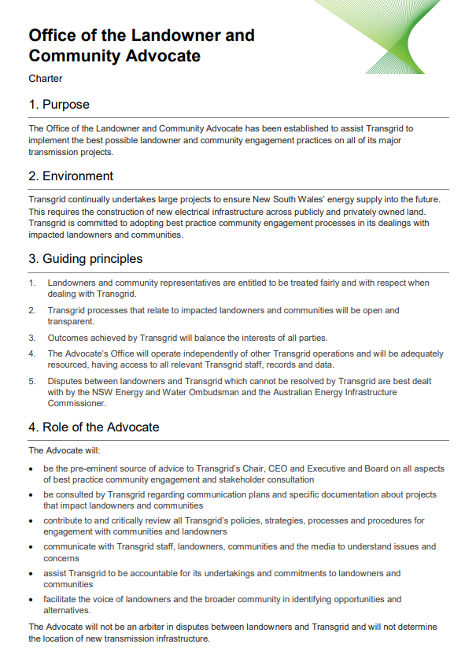
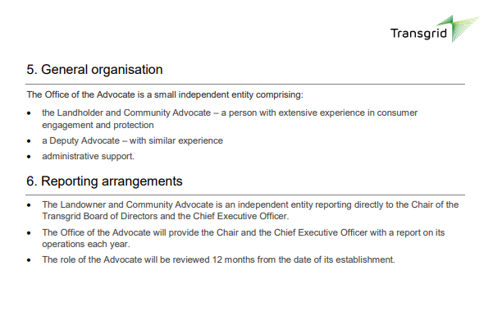
Landowner and Community Advocate –
establishment & objectives
In late 2020 Transgrid created the Office of the Landowner & Community Advocate to assist the organisation to implement best possible landowner and community engagement practices on all its major transmission projects
These principles were encapsulated in the Charter which we prepared and which Transgrid endorsed

Slide 3
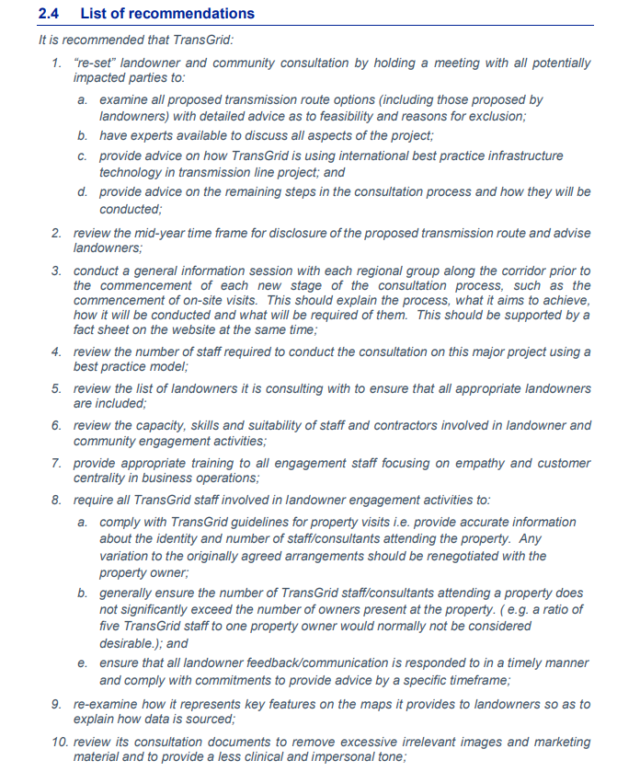
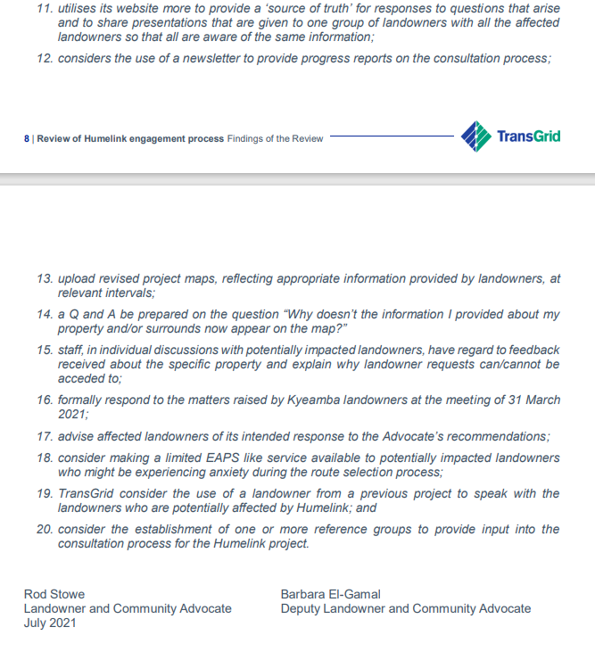
Landowner and Community Advocate
– recommendations

Slide 4
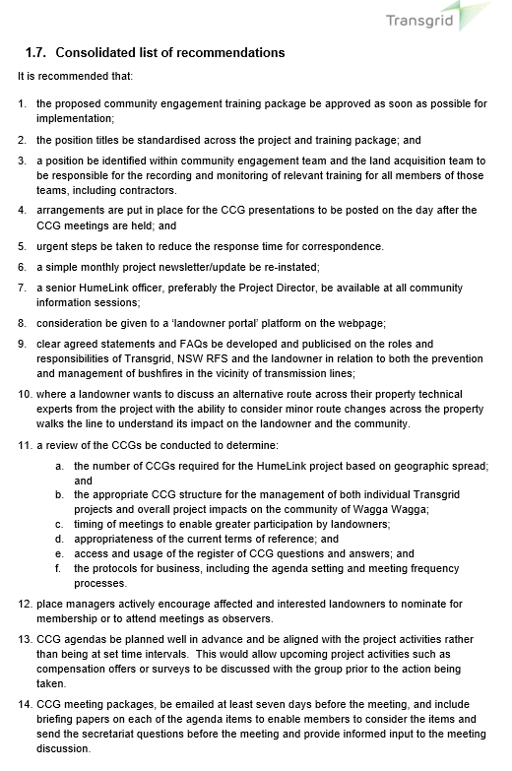
Landowner and Community Advocate
– further 12 month review
In the second half of last year Transgrid requested the Advocate revisit community engagement on the HumeLink project and to provide observations on the impact of the previous review’s recommendations, as well as any learnings that might have application across the board
Using a similar methodology to the earlier review, we concluded that there was general stakeholder acknowledgment and appreciation of the additional resources that Transgrid had committed
We observed that there continued to be concerns over how some engagement initiatives had been executed. As a consequence, we made a number of further recommendations

Slide 5
Landowner and Community Advocate – noted improvements
General landowner observation that Transgrid’s engagement had improved considerably
Significant increase in staffing resources
Development of landowner-centric training packages, including the e-module (corporate induction)
Establishment of Community Consultative Groups
Improved systems for managing correspondence
Improved information on the HumeLink webpage
Significant improvement in the interactive maps of the proposed transmission line route
Establishment of an Engagement Management team
Development of a detailed easement acquisition package and other document templates/ procedures

Slide 6
Questions?

